Slide 1
Relational Model (MIX)
Sumber: Silberschatz, Korth and Sudarshan, Database System Concepts, 6th Ed.
Jeffrey A. Hoffer, Mary B. Prescott, Fred R. McFadden, Modern Database Management, 8th Ed.
Program Studi Teknik Informatika
Institut Teknologi Bandung

Slide 2
Learning Outcomes
Define the fundamental terminology used in the relational data model
Describe the basic principles of the relational data model
OBJECTIVES
How relational database model takes a logical view of data
Understand how the relational model’s basic components are relations implemented through tables in a relational DBMS
How relations are organized in tables composed of rows (tuples) and columns (attributes)
Use relational database operators, the data dictionary, and the system catalog
How data redundancy is handled in the relational database model
Why indexing is important

Slide 3

Overview Database Modeling Process
EKSTERNAL - USER
Clients Inputs
DUA PENDEKATAN BERBEDA, TETAPI MEMBERIKAN MAKNA YANG SAMA
ER/EER Model
LOGICAL LEVEL
Relational Model
Relational Database System
PHYSICAL LEVEL
Client App 2
Client App 1
INTERNAL - STORAGE

Slide 4
Relational Model Concepts
A Relation is a mathematical concept based on the ideas of sets
The model was first proposed by Dr. E.F. Codd of IBM Research in 1970 in the following paper:
"A Relational Model for Large Shared Data Banks," Communications of the ACM, June 1970
The above paper caused a major revolution in the field of database management and earned Dr. Codd the coveted ACM Turing Award

Slide 5
Why Study the Relational Model?
Most widely used model.
Vendors: IBM, Informix, Microsoft, Oracle, Sybase, etc.
“Legacy systems” in older models
E.G., IBM’s IMS
Recent competitor: object-oriented model
ObjectStore, Versant, Ontos
A synthesis emerging: object-relational model
Informix Universal Server, UniSQL, O2, Oracle, DB2
Notes:
2

Slide 6
Relation
Definition: A relation is a named, two-dimensional table of data
Table consists of rows (records) and columns (attribute or field)
Requirements for a table to qualify as a relation:
It must have a unique name
Every attribute value must be atomic (not multivalued, not composite)
Every row must be unique (can’t have two rows with exactly the same values for all their fields)
Attributes (columns) in tables must have unique names
The order of the columns must be irrelevant
The order of the rows must be irrelevant
NOTE: all relations are in 1st Normal form

Slide 7
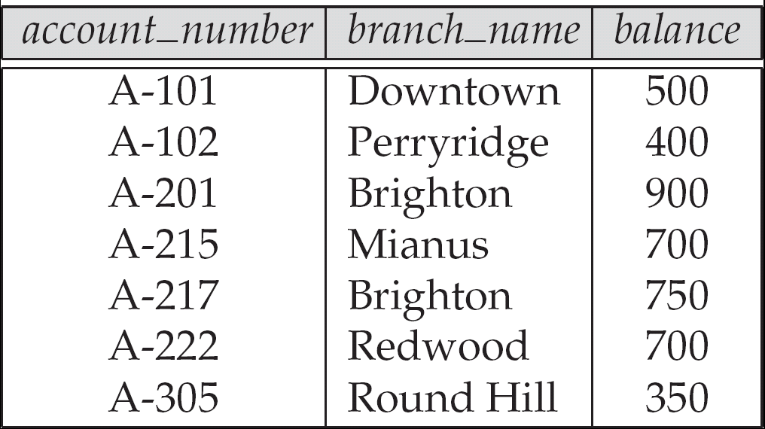
Example of a Relation

Slide 8
Attribute Types
Each attribute of a relation has a name
The set of allowed values for each attribute is called the domain of the attribute
Attribute values are (normally) required to be atomic; that is, indivisible
E.g. the value of an attribute can be an account number, but cannot be a set of account numbers
Domain is said to be atomic if all its members are atomic
The special value null is a member of every domain
The null value causes complications in the definition of many operations
We shall ignore the effect of null values in our main presentation and consider their effect later
Meanings for NULL values
Value unknown
Value exists but is not available, ex: restricted
Attribute does not apply to this tuple (also known as value undefined)
IMPORTANT: NULL ≠ NULL
Notes:
Indivisible = tidak dapat dibagi

Slide 9
Relation Schema
Formally, given domains D₁, D₂, …. D_{n} a relation r is a subset of D₁ x D₂ x … x D_{n} Thus, a relation is a set of n-tuples (a₁, a₂, …, a_{n}) where each a_{i} ∈ D_{i}
Schema of a relation consists of
attribute definitions
name
type/domain
integrity constraints
Notes:
Relasi r adalah cartesian product dari D1xD2xD3… dst..
Artinya, Relasi r merupakan pasangan domain Dx.. yg sesuai..

Slide 10
Relation Instance
The current values (relation instance) of a relation are specified by a table
An element t of r is a tuple, represented by a row in a table
Order of tuples is irrelevant (tuples may be stored in an arbitrary order)
attributes
(or columns)
customer_name
customer_street
customer_city
Jones
Smith
Curry
Lindsay
Main
North
North
Park
Harrison
Rye
Rye
Pittsfield
tuples
(or rows)
customer

Slide 11
Example Instance of Students Relation
Cardinality = 3, degree = 5, all rows distinct

Slide 12
Formal Definitions - Summary
Formally,
Given R(A1, A2, .........., An)
r(R) ⊂ dom (A1) X dom (A2) X ....X dom(An)
R(A1, A2, …, An) is the schema of the relation
R is the name of the relation
A1, A2, …, An are the attributes of the relation
r(R): a specific state (or instance or "value" or “population”) of relation R – this is a set of tuples (rows)
r(R) = {t1, t2, …, tn} where each ti is an n-tuple
ti = <v1, v2, …, vn> where each vj element-of dom(Aj)
Notes:
- ⊂ = lambang subset atau bagian

Slide 13
Database Schema & Relation Schema
Database:
Database schema -> logical design of database
Database instance -> snapshot of the data in db
Database schema:
Set of Relational schema
Relational schema -> list of attributes and their corresponding domains
Examples:
Branch = (branch-name, branch-city, assets)
Account = (account-number, branch-name, balance)

Slide 14
Database
A database consists of multiple relations
Information about an enterprise is broken up into parts, with each relation storing one part of the information
E.g.
account : information about accounts depositor : which customer owns which account customer : information about customers

Slide 15
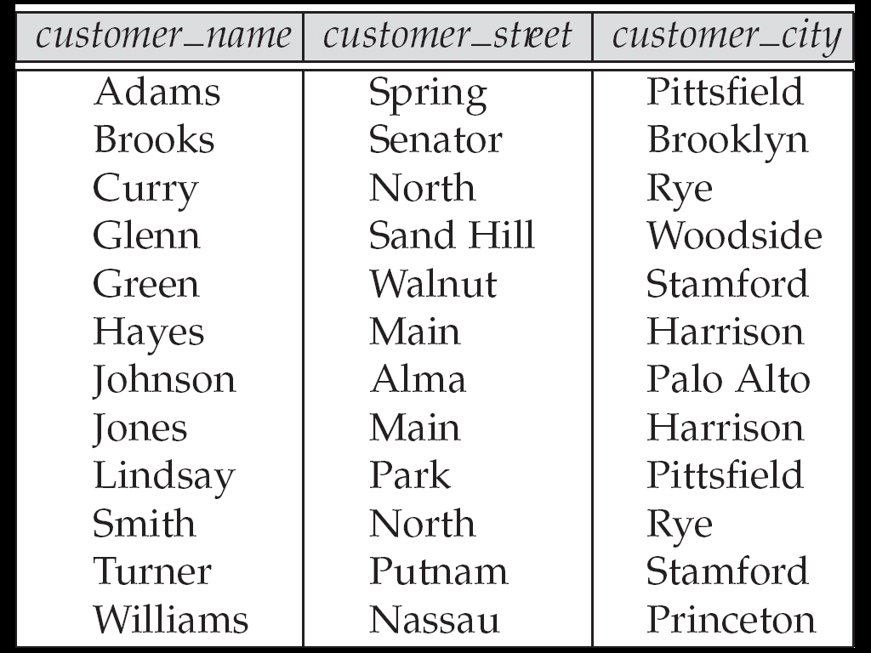
The customer Relation

Slide 16
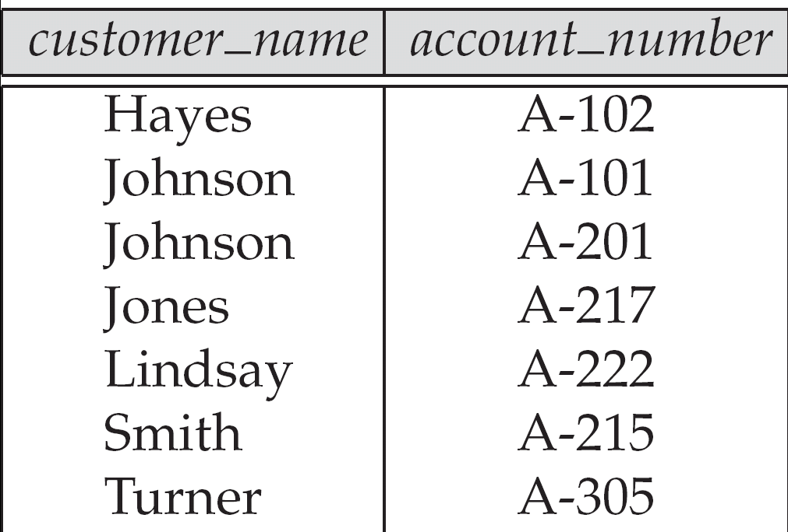
The depositor Relation

Slide 17
Why Split Information Across Relations?
Storing all information as a single relation such as bank(account_number, balance, customer_name, ..) results in
repetition of information
e.g.,if two customers own an account (What gets repeated?)
the need for null values
e.g., to represent a customer without an account
Normalization theory (later topic) deals with how to design relational schemas
Notes:
Coba bayangkan, apabila data nasabah digabungkan dengan data pinjaman, tidak peduli orang ini punya pinjaman atau tidak
Itu baru dua jenis data, bagaimana kalo jenis data lain juga digabung pada satu tabel saja

Slide 18
Keys
Let K ⊆ R
K is a superkey of R if values for K are sufficient to identify a unique tuple of each possible relation r(R)
by “possible r ” we mean a relation r that could exist in the enterprise we are modeling.
Example: {customer_name, customer_street} and {customer_name} are both superkeys of Customer, if no two customers can possibly have the same name
In real life, an attribute such as customer_id would be used instead of customer_name to uniquely identify customers, but we omit it to keep our examples small, and instead assume customer names are unique.
Notes:
Sufficient = cukup
Omit = mengabaikan

Slide 19
Keys (Cont.)
K is a candidate key if K is minimal Example: {customer_name} is a candidate key for Customer, since it is a superkey and no subset of it is a superkey.
Primary key: a candidate key chosen as the principal means of identifying tuples within a relation
Should choose an attribute whose value never, or very rarely, changes.
E.g. email address is unique, but may change
Keys can be simple (a single field) or composite (more than one field)
Keys usually are used as indexes to speed up the response to user queries

Slide 20
Foreign Keys
A relation schema may have an attribute that corresponds to the primary key of another relation. The attribute is called a foreign key.
E.g. customer_name and account_number attributes of depositor are foreign keys to customer and account respectively.
Only values occurring in the primary key attribute of the referenced relation may occur in the foreign key attribute of the referencing relation.

Slide 21
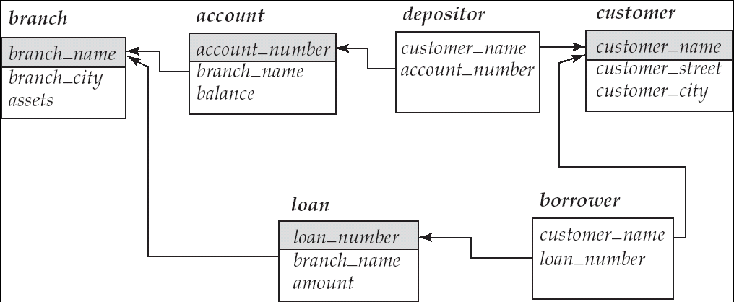
Schema Diagram
Foreign Keys

Slide 22
Integrity Constraints
Domain Constraints
Allowable values for an attribute. See Table 5-1 (next slide)
Typically include:
Numeric data types for integers and real numbers
Characters
Booleans
Fixed-length strings
Variable-length strings
Date, time, timestamp
Money
Other special data types

Slide 23
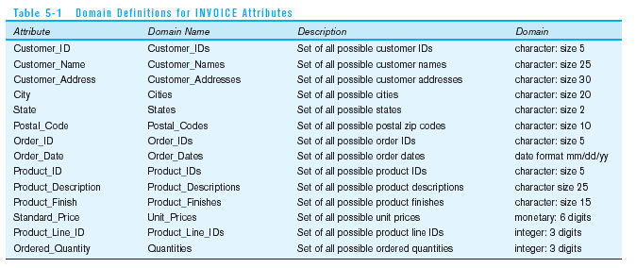
Domain definitions enforce domain integrity constraints

Slide 24
Integrity Constraints
Entity Integrity
No primary key attribute may be null. All primary key fields MUST have data
Action Assertions
Application-based or semantic constraints or business rules
Cannot be directly expressed in schemas
Expressed and enforced by application program

Slide 25
Integrity Constraints
Referential Integrity–rule states that any foreign key value MUST match a primary key value in the referenced relation (Or the foreign key can be null)
Formal Definition
Let r₁(R₁) and r₂(R₂) be relations with primary keys K₁ and K₂ respectively.
The subset α of R₂ is a foreign key referencing K₁ in relation r₁, if for every t₂ in r₂ there must be a tuple t₁ in r₁ such that t₁[K₁] = t₂[α].
For example: Delete Rules
Restrict–don’t allow delete of “parent” side if related rows exist in “dependent” side
Cascade–automatically delete “dependent” side rows that correspond with the “parent” side row to be deleted
Set-to-Null–set the foreign key in the dependent side to null if deleting from the parent side → not allowed for weak entities

Slide 26
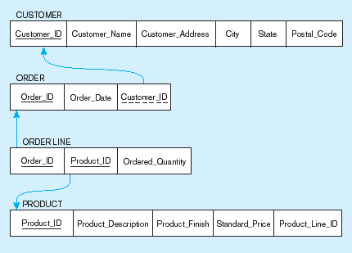
Figure 5-5
Referential integrity constraints (Pine Valley Furniture)
Referential integrity constraints are drawn via arrows from dependent to parent table

Slide 27
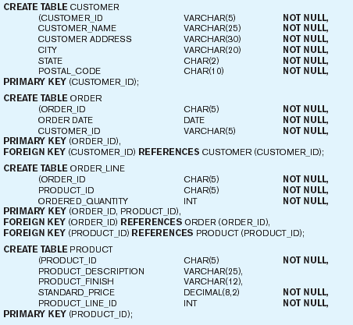
Figure 5-6 SQL table definitions
Referential integrity constraints are implemented with foreign key to primary key references

Slide 28
Query Languages
Language in which user requests information from the database.
Categories of languages
Procedural
Non-procedural, or declarative
“Pure” languages:
Relational algebra
Tuple relational calculus
Domain relational calculus
Pure languages form underlying basis of query languages that people use.

Slide 29
Exercise 1
Consider the following relations for a database that keeps track of student enrollment in courses and the books adopted for each course:
STUDENT(SSN, Name, Major, Bdate)
COURSE(Course#, Cname, Dept)
ENROLL(SSN, Course#, Quarter, Grade)
BOOK_ADOPTION(Course#, Quarter, Book_ISBN)
TEXT(Book_ISBN, Book_Title, Publisher, Author)
Draw a relational schema diagram specifying the foreign keys for this schema.

Slide 30
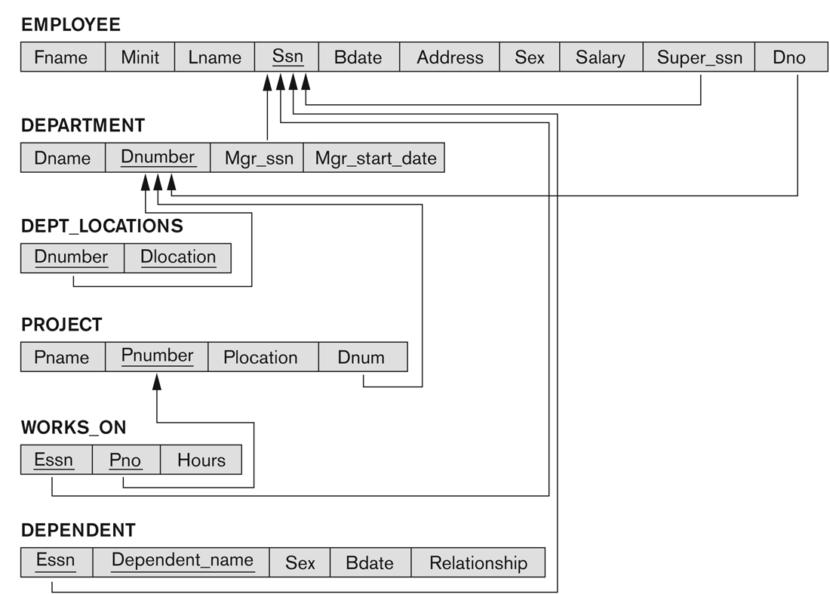
Exercise 2
Exercise 2: Relational Schema Diagram for COMPANY database

Slide 31
Exercise 2
Give potential constraint violations when updating the info of a departement.
Dname
Dnumber
Mgr_SSN
Mgr_start_date
Actions and consequences to avoid constraint violations when deleting a department
REJECT/RESTRICT
CASCADE
SET TO NULL

